Slide 1
Implementation of Lexical Analyzer

Slide 2
Main Purpose of Lexical Analyzer
This is 1st phase of a compiler.
It will read the source code and will generate tokens for the parser(2nd phase of compiler).
So, it will process a sequence of characters to tokens.
Example:
int a=2+3;
Tokens:
<INT>< ID, a> <ASSIGNOP> <NUMBER,2> <ADDOP>< NUMBER,3> <SEMICOLON>

Slide 3
Role of lexical Analyzer
Identify tokens
Insert lexemes into Symbol Table
Remove all white spaces
Return Tokens to Parser

Slide 4
How will we build Lexical Analyzer?
From Scratch?
No! There are tools that generate lexer.

Slide 5
Life Savers
lex
– Lexical Analyzer Generator
Not used anymore
flex
– Free, open source alternative
– We will use this

Slide 6
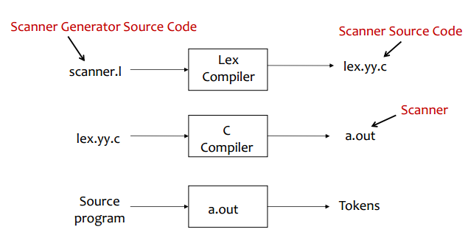
Flex/lex

Slide 7
flex program Structure
/**** Definition Section ******/
%%
/**** Rules Section ********/
%%
/**** User SubRoutines *******/

Slide 8
Definition Section
%option noyywrap
%{
#include<stdio.h>
#include<stdlib.h>
int line_count=0;
%}
whitespace [ \t\v\f\r]+
newline [\n]
%%
Options
C Code
Definitions

Slide 9
Rules Section
Rules Section may includes
Pattern Lines
C code to be copied in lex.yy.c
Usually it only contains some pattern
lines with corresponding actions
Example:
{newline} {printf("newline is found\n");line++;}
newline is already defined in the definition section.
line is a variable name, which also should be defined in the definition section.

Slide 10
More examples of rules
Keyword:
"if" { printf("<IF>\n"); fprintf(token,"<IF>"); fprintf(logout,"Line no %d:Token <IF> lexeme %s is found\n",line,yytext); }
printf → print in the console
fprintf in 2nd line→ print in the token file
fprintf in 3rd line→ print in the logout file

Slide 11
Subroutine Section
%%
int main(int argc, char **argv){
yyin= fopen(argv[1], "r");
yylex(); // this function matches the pattern with the input file
fclose(yyin);
return 0;
}
Subroutine section usually includes C code to be copied in lex.yy.c file

Slide 12
Input File
A simple C Code:
int main(){
int x,y;
char c;
x=10;
y= 5;
return 0;
}

Slide 13
Output Token file
<INT> <ID,main> <LPAREN,(> <RPAREN,)> <LCURL,{> <INT> <ID,x> <COMMA,,> <ID,y> <SEMICOLON,;> <CHAR><ID,c> <SEMICOLON,;> <ID,x> <ASSIGNOP,=> <CONST_INT,10> <SEMICOLON,;> <ID,y> <ASSIGNOP,=> <CONST_INT,5> <SEMICOLON,;> <RETURN> <CONST_INT,0> <SEMICOLON,;> <RCURL,}>

Slide 14
Output in Token File
<INT><ID,main><LPAREN,(><RPAREN,)><LCURL,{><INT><ID,x><COMMA,,><ID,y><SEMICOLON,;><CHAR><ID,c><SEMICOLON,;><ID,x><ASSIGNOP,=><CONST_INT,10><SEMICOLON,;><ID,y><ASSIGNOP,=><CONST_INT,5><SEMICOLON,;><RETURN><CONST_INT,0><SEMICOLON,;><RCURL,}>

Slide 15
Steps to generate a Lexical Analyzer
Step1: Install flex for windows (I will give you a link to download and install, you can also run it in ubuntu)
Step 2: Open or create a lex file (name.l file)
Step 3: Add definitions, patterns and subroutine as per requirement
Step 4: Include the SymbolTable in your lex file so that you can add lexemes in your table.

Slide 16
Identifying Tokens
Keywords
You have to identify lexeme of the keywords given in Table 1 and print token <Keyword_name> in the output file. For example, you will print <IF> in case you find the keyword “if” in source program. Keywords will not be inserted in the symbol table.
You have to implement all the keywords given in the Table 01 (Slide 17).

Slide 17
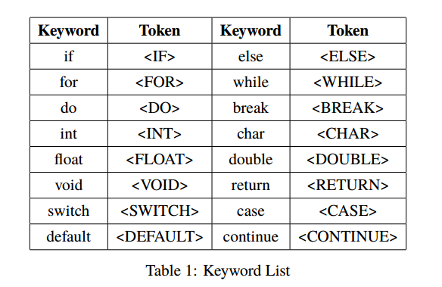
Keyword List

Slide 18
Tokens
Constants
For each constant you have to print a token in <CONST_type, Symbol> in the output file and insert the symbol in symbol table.
Integer Literals: One or more consecutive digits form an integer literal. Token name will be CONST_INT.
Floating Point Literals: Numbers like 3.14159, 3.14159E-10 and 314159E10 will be considered as floating point constants. In this case, token name will be CONST_FLOAT.
Character Literals: Character literals are enclosed in single quotes. There will be a single character within the single quotes with the exception of ‘\n’, ‘\t’, ‘\\’, ‘\“’, ‘\a’, ‘\f’, ‘\r’, ‘\b’, ‘\v’ and ‘\0’. For character literals token name will be CONST_CHAR.

Slide 19
Tokens
Operators and Punctuators
The operator list for the subset of C program we are dealing with is given in Table 2. A token in the form of <TOKEN_NAME,Symbol> should be printed in the output file and the operator should be inserted in the symbol table.

Slide 20
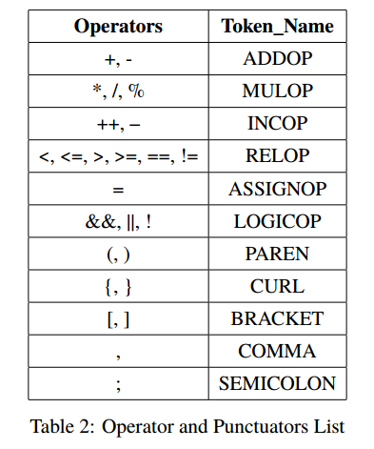
Operator and Punctuators List

Slide 21
Tokens
Identifiers
Identifiers are names given to C entities, such as variables, functions, structures etc. An identifier can only have alphanumeric characters( a-z , A-Z , 0-9 ) and underscore( _ ). The first character of an identifier can only contain alphabet( a-z , A-Z ) or underscore ( _ ). For any identifier encountered in the input file you have to print token <ID,Symbol> and also insert it in the symbol table.

Slide 22
More Details
Adding definitions in the definition section:
whitespace
newline
digit
digits
letter
letters
alphanum

Slide 23
More details
Keywords:
I have already shown you the code structure for “if”. Similarly, you can add all the keywords in the rules section.

Slide 24
More details
CONST_INT:
One or more consecutive digits.
Can you guess the regular expression?
CONST_FLOAT:
Can you guess the regular expression? Already taught in class.
CONST_CHAR:
2 types
Single character enclosed by single quote
some given exceptions

Slide 25
Tasks of Assignment-01
Tasks (Tentative) | Marks
Installation of flex (Windows or Ubuntu)
Creation of lex file
Add the SymbolTable
Write a structure (Definition, rule, subsection)
Add pattern for keywords
Add pattern for constants
Add pattern for operators
Add pattern for identifiers
Generation of a Token file properly

